Slide 1

KAVIKULGURU INSTITUTE OF SCIENCE AND TECHNOLOGY, RAMTEK-441106
Shreya Patle (CT18123)
Rutuja Kale (CT18037)
Shubham Chambhare (CT18125)
Prachi Patel (CT18031)
Raghav Shukla (CT18121)
Guided by :
Dr. V. P. Mahatme (Head Of CT Department)
DEPARTMENT OF COMPUTER TECHNOLOGY
2020 - 2021

Slide 2

COMPARATIVE STUDY AND IMPLEMENTATION OF ALGORITHMS IN MACHINE LEARNING.
Presentation on

Slide 3
CONTENTS
01
02
03
Introduction
Problem statement and objectives
Literature review
Overview of machine learning algorithms.
Here we define the problem statement and the points belongs to the project.
Research papers and information belongs to the respected paper.

Slide 4
CONTENTS
04
05
06
Proposed approach and system architecture
Implemented work
Result and conclusion
Approach we follow for this project and the flow diagram about it.
Steps by step process and the work implementation.
Result about the implemented work and conclusion.

Slide 5
Introduction
The term Machine Learning was coined by Arthur Samuel in 1959, an American pioneer in the field of computer gaming and artificial intelligence, and stated that “it gives computers the ability to learn without being explicitly programmed”. Machine learning is a growing technology which enables computers to learn automatically from past data. Machine Learning (ML) is a subfield of artificial intelligence (AI). The goal of machine learning generally is to understand the structure of data and fit that data into models that can be understood and utilized by people. Although machine learning is a field within computer science, it differs from traditional computational approaches.

Slide 6
At a broad level, machine learning can be classified into three types:
Supervised learning
Unsupervised learning
Reinforcement learning

Slide 7
Machine learning algorithms
K Nearest Neighbours Algorithm.
Linear Regression Algorithm.
Support Vector Machine Algorithm.
Logistic Regression Algorithm.
Naïve Bayes Classifier Algorithm.
Decision Trees Algorithm.
Random Forests Algorithm.
Artificial Neural Networks Algorithm.
K Means Clustering Algorithm.
Apriori Algorithm

Slide 8
Objectives
Problem statement
Comparative Study and Implementation of Algorithms in Machine Learning.
To study theory and concepts of Python.
To study various machine learning algorithms.
To implement machine learning algorithms using Python.
To validate machine learning K-NN algorithm on different data sets.
To implement handwritten digit classifier using K-NN algorithm.

Slide 9
Literature review
Ayon Dey. “Machine Learning Algorithms: A Review”. Department of CSE, Gautam Buddha University, India. 2016. Vol. 7 (3).
This paper surveys various machine learning algorithms. Today each and every person is using machine learning knowingly or unknowingly. From getting a recommended product in online shopping to updating photos in social networking sites. This paper gives an introduction to most of the popular machine learning algorithms.
Lishan Wang. ‘‘Research and Implementation of Machine Learning Classifier Based on KNN’’. Fujian Normal University, Fuzhou 350108, China. (2019)
This paper implements the KNN machine learning classifier, and the results of the data test show that the basic goal is achieved and the classification effect is achieved. The KNN classification algorithm is subjective because a distance scale must be defined. Since the understanding of the distance is not profound, the result of the classification depends entirely on the distance used. Since the recognition of results is often empirical, this limits the use of various distances.

Slide 10
Literature review
Siddhartha Roy, M.Saravanan. “Handwritten Character Recognition using K-NN Classification Algorithm”. Computer Science Engineering, SRM University, Chennai, India. Vol-3 Issue-5 (2017)
In this paper we used ten (10) features for recognition of handwritten numerals. In any recognition process, the important problem is to address the extraction of feature and correct classification approaches. The proposed algorithm tries to deal with both the factors and well in terms of accuracy and time complexity. The Overall accuracy of 97.67% is achieved in the recognition process.
Andreas C. Müller,Sarah Guido.‘‘Introduction to Machine Learning with Python-A Guide for Data Scientists’’. O’Reilly Media, Inc., 1005 Gravenstein Highway North, Sebastopol, CA 95472 (2016)
This book mentioned that k-NN algorithm is arguably the simplest machine learning algorithm. Building the model consists only of storing the training dataset. To make a prediction for a new data point, the algorithm finds the closest data points in the training dataset—its “nearest neighbors.”

Slide 11
Proposed approch
In a K-Nearest Neighbors Algorithm, the proposed method uses k-nearest neighbor (knn) classification algorithm for classifying the MNIST digit images in test set using the feature vector of training database.
The k-nearest neighbor algorithm (k-NN) is a classification technique which classify the objects base on training features space.
The functionality of k-NN algorithm is to define the computations until classification is done irrespective of the learning techniques.
Generally, k-NN has two learning techniques. They are Instance-based and Lazy learning techniques. K-nearest neighbor algorithm is simplest classification technique because of computations are simple.

Slide 12
SYSTEM ARCHITECTURE
Input unit
Pre Processing
Pixelated
Image
Feature
extraction
Train
data
mnist
dataset
kNN
algorithm
Processing unit
Test
data
Digit
recognition
Output unit
Digitized
output
Post processing
Display

Slide 13
REQUIREMENTS
Python
JUPyTER notebook
Mnist dataset
Pandas library
Numpy library
Matplotlib
Python 3.8 or above.
jupyter notebook for implemting code.
Digit dataset for implementing algorithm.
Pandas lib. For reading dataset.
Numpy lib. For creating random arrays.
For ploting the numpy arrarys.

Slide 14
implementation
Creating own kNN algorithm with the help of python.
Reading the mnist dataset and exploring the given values in it.
Splitting the given dataset into features (X) and labels (y).
Dividing the features and labels columns into training data and testing data.
Applying the kNN algorithm for the given data and predicting the test digit.

Slide 15
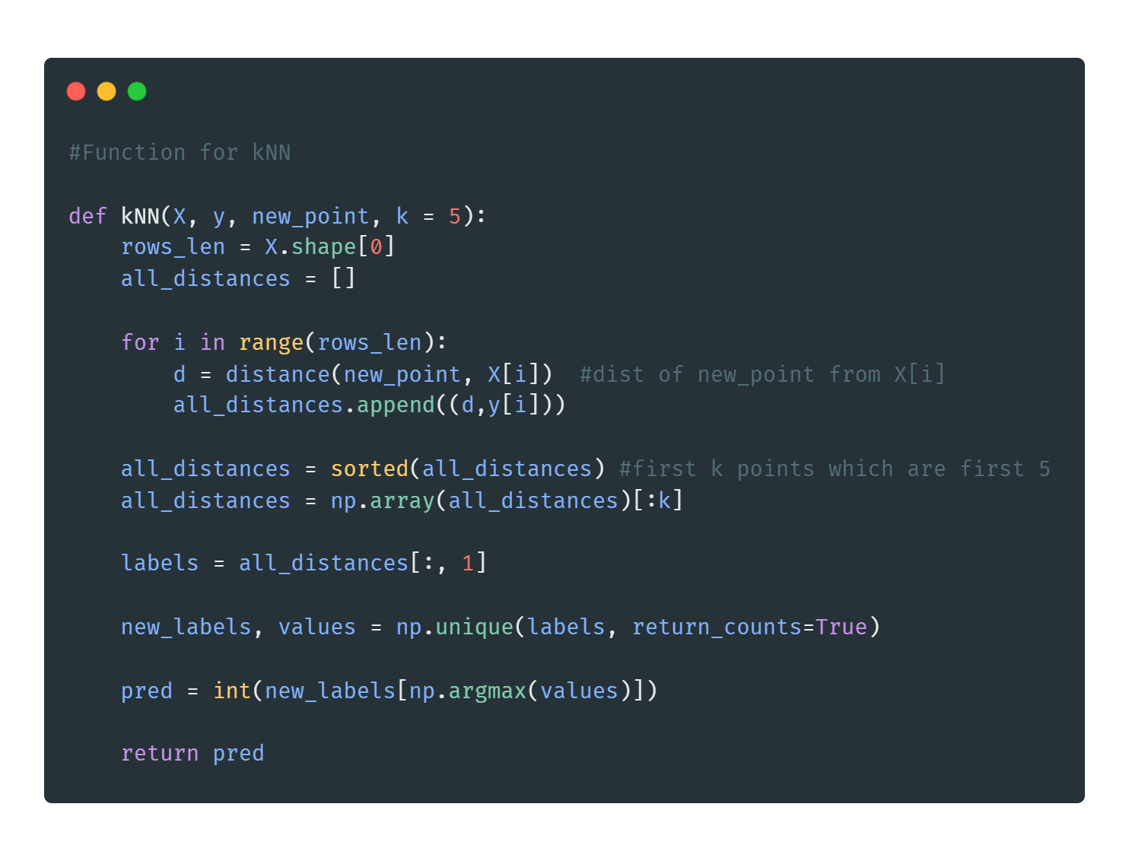
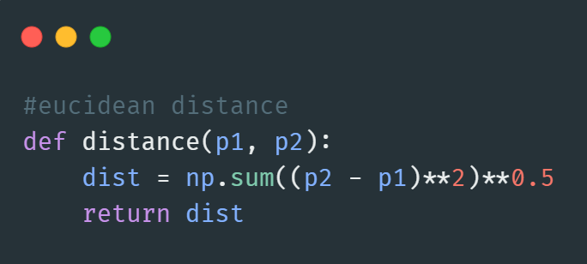
Creating own kNN algorithm with the help of python.

Slide 16
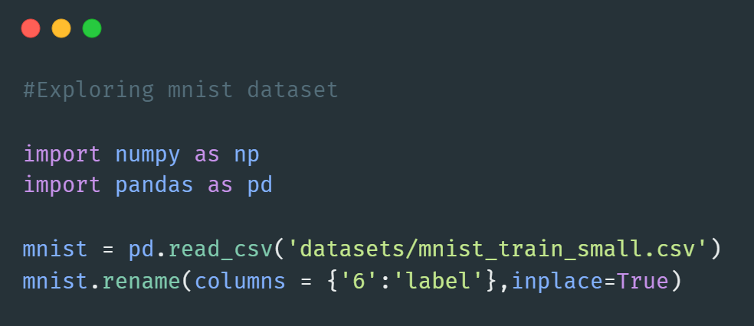
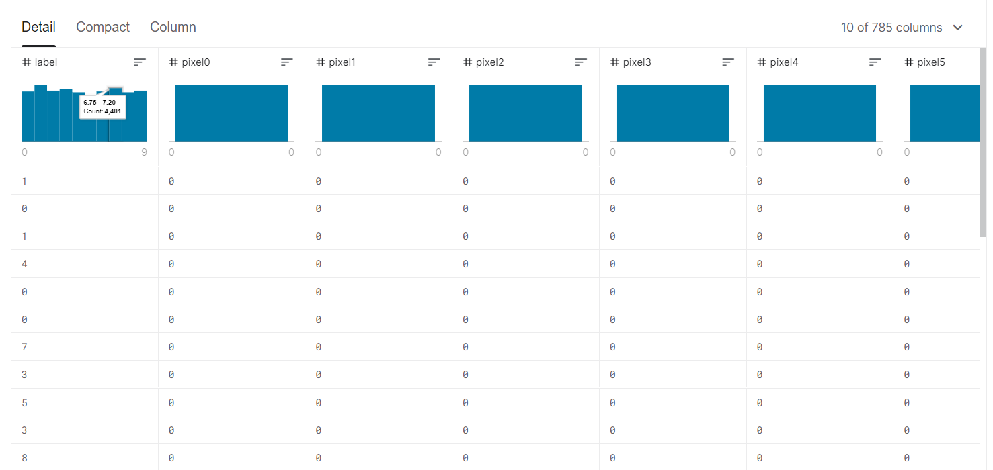
Reading the mnist dataset and exploring the given values in it.
The given dataset contain 19999 rows and 785 columns with gray-scale images of hand-drawn digits from zero through nine. Each image is 28 pixels in height and 28 pixels in width, for a total of 784 pixels in total. This pixel-value is an integer between 0 and 255, inclusive.

Slide 17
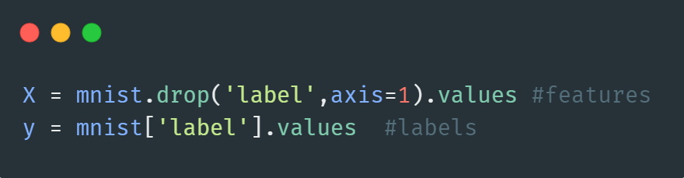
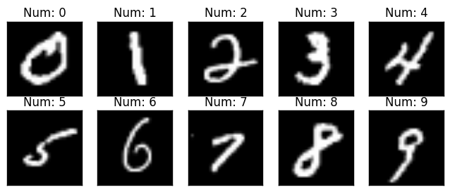
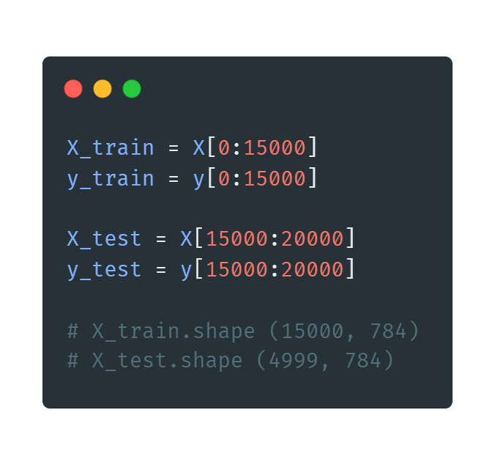
Splitting the given dataset into features (X) and labels (y).
Dividing the features and labels columns into training data and testing data.

Slide 18
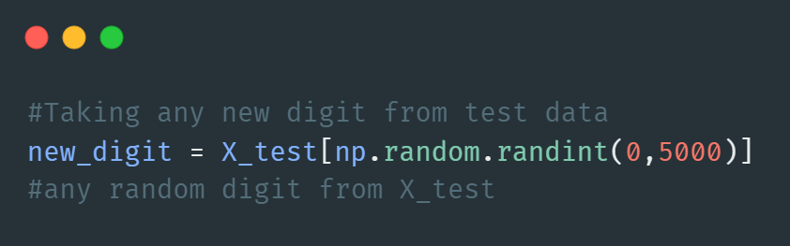
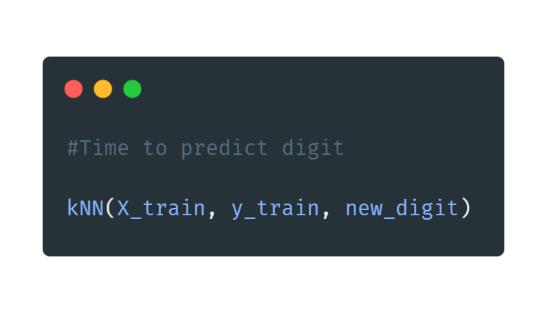
Applying the kNN algorithm for the given data and predicting the test digit.

Slide 19
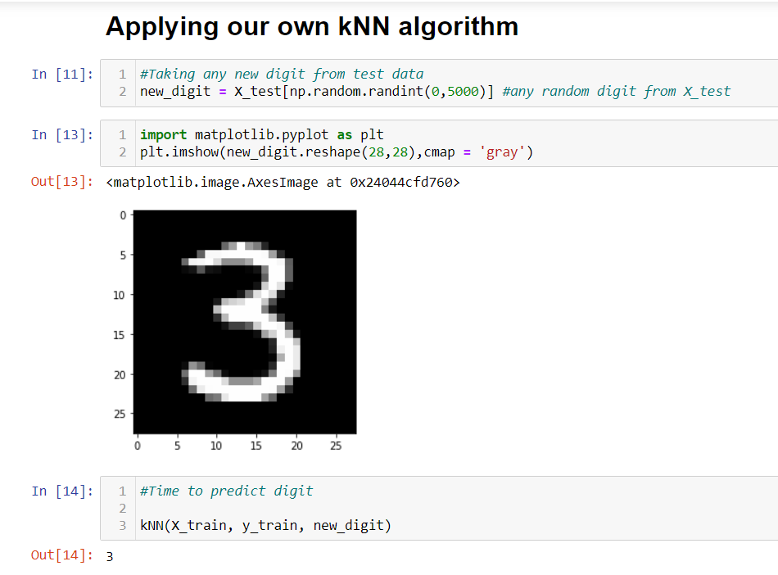
result
As we predict the new digit we got from random array from test data is 3 and we check before prediction its ploted as 3.
Our kNN algorithm model works fine for classifing the any random digit.

Slide 20
Conclusion
Limitations of the Study
Machine Learning Algorithms Require Massive Stores of Training Data.
Learning must generally be supervised: Training data must be tagged.
Labelling Training Data Is a Tedious Process.

Slide 21
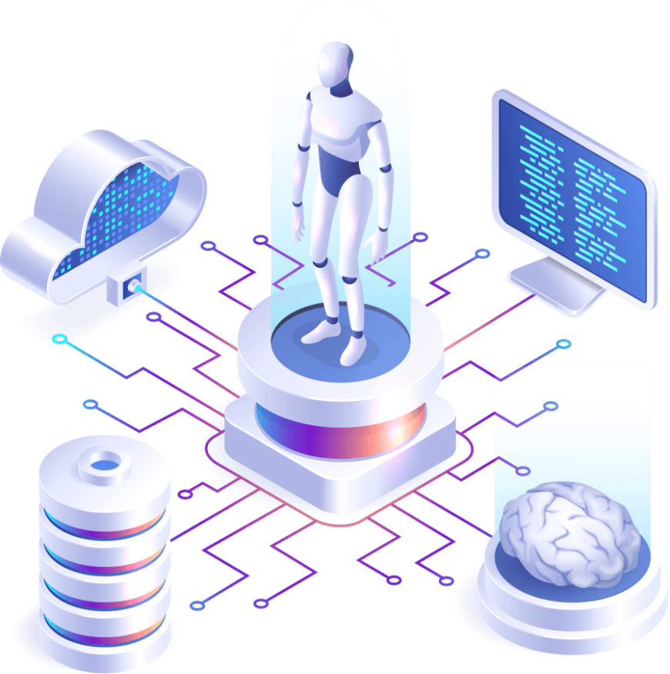
Future scope of work
Automotive Industry.
Robotics.
Quantum Computing.
Computer vision.
Digital Marketing.
Health care.

Slide 22
References
https://www.tutorialspoint.com/r/r_overview.html. Accessed on: 5th April 2021 at 2.15 p.m.
https://www.youtube.com/results?search_query=r+edureka . Accessed on: 20th April 2021 at 1.30 p.m.
https://www.tutorialspoint.com/python. Accessed on: 2nd April 2021 at 3.00 p.m.
https://www.expertsystem.com/machine-learning-definition. Accessed on: 9th April 2021 at 11.30 a.m.
https://ijarcce.com/upload/2017/april-17/IJARCCE%202.pdf. . Accessed on: 2nd April 2021 at 11.30 a.m.
https://www.analyticsvidhya.com/blog/2017/09/common-machine-learning-algorithms/ Accessed on: 1st April 2021 at 2.15 p.m.
Ayon Dey. “Machine Learning Algorithms: A Review”. Department of CSE, Gautam Buddha University, India. 2016. Vol. 7 (3). Accessed on: 18th April 2021 at 11.00 a.m.
Lishan Wang. ‘‘Research and Implementation of Machine Learning Classifier Based on KNN’’. Fujian Normal University, Fuzhou 350108, China. (2019). Accessed on: 18th April 2021 at 1.00 p.m.

Slide 23
THANK you!
You can get our code from the given link
GitHub link:
https://github.com/Shubham654/STUDY-AND-IMPLEMENTATION-OF-ALGORITHMS-IN-MACHINE-LEARNING.

